Slide 1


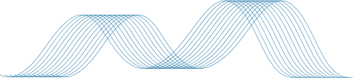

WELLCOME
TO OUR PRESENTATION
Presented To
A S M Kamrul Islam
Lecture
Green University of Bangladesh
01

Slide 2
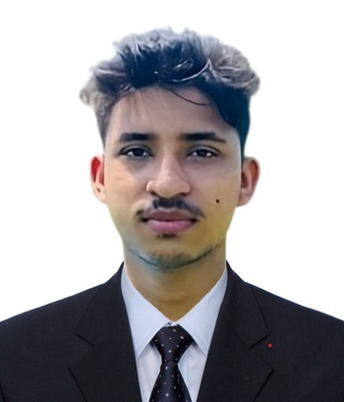
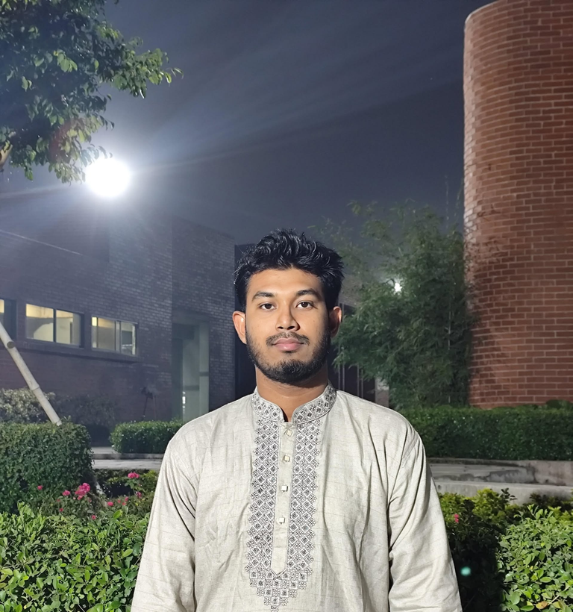

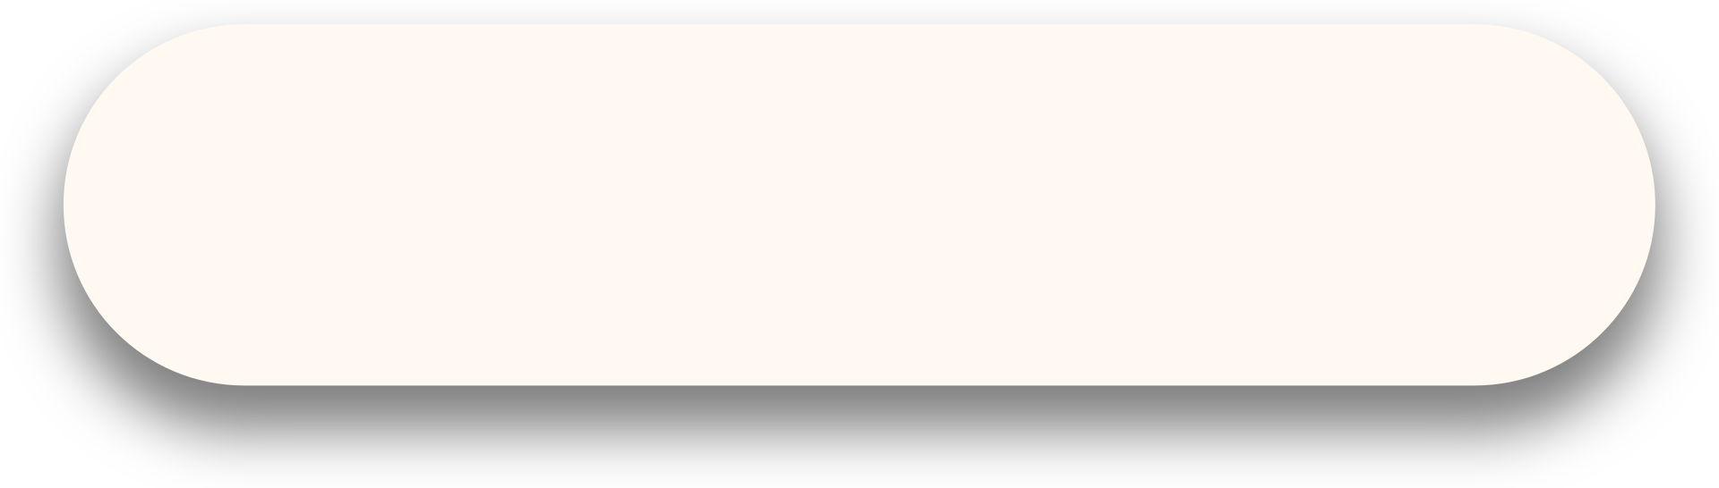
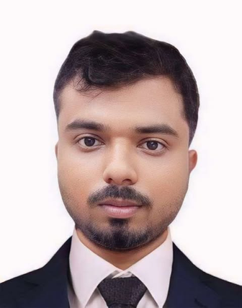


MEET THE GORUP
Arman
Nahid
Saminur
Sajib
Nazmul
02

Slide 3
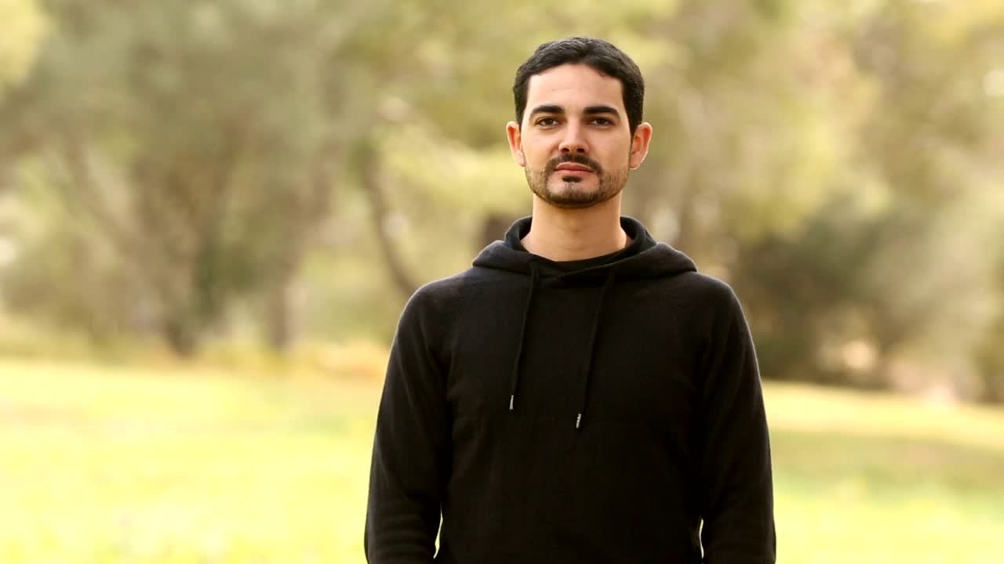



Content
01
what is deepfake?
02
why is deepfake unethical?
03
Title
deepfake’s effect on society
Misuse of aI Deepfake Technology
04
What Can We Do? (Solutions)
05
conclusion
03

Slide 4



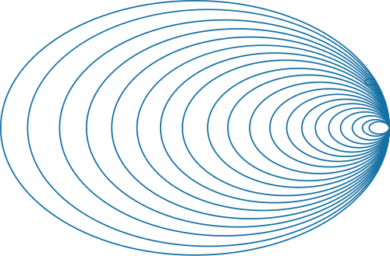
What is deepfake
Hard to detect
Can easily mislead people
Fake videos/audios created using AI
04

Slide 5

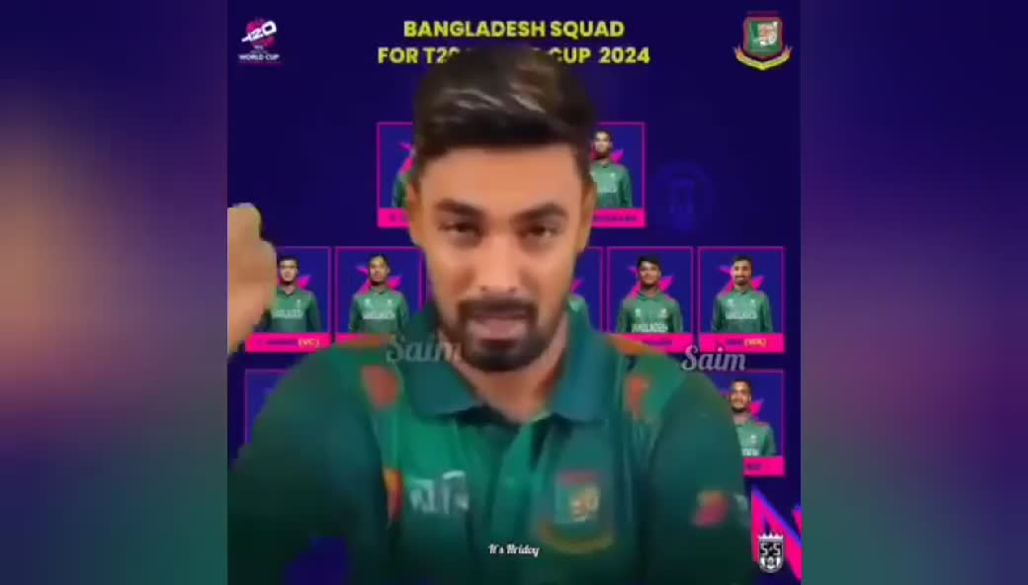

Real-Life Cases
05

Slide 6

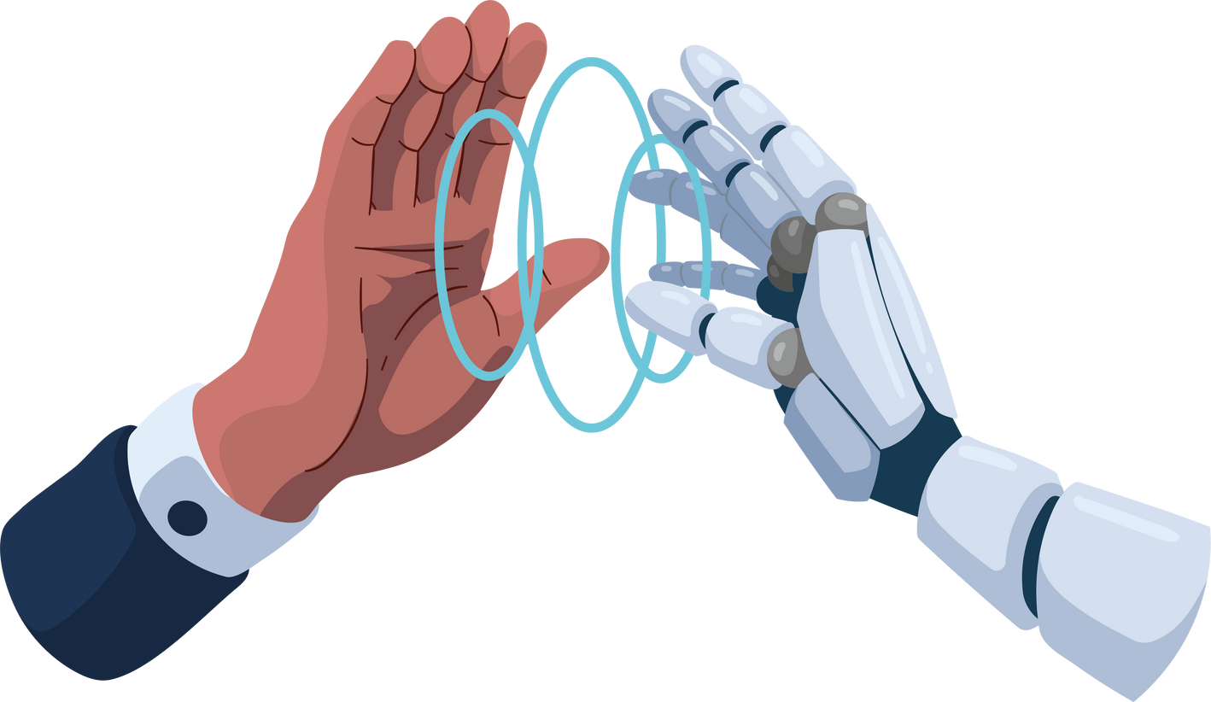
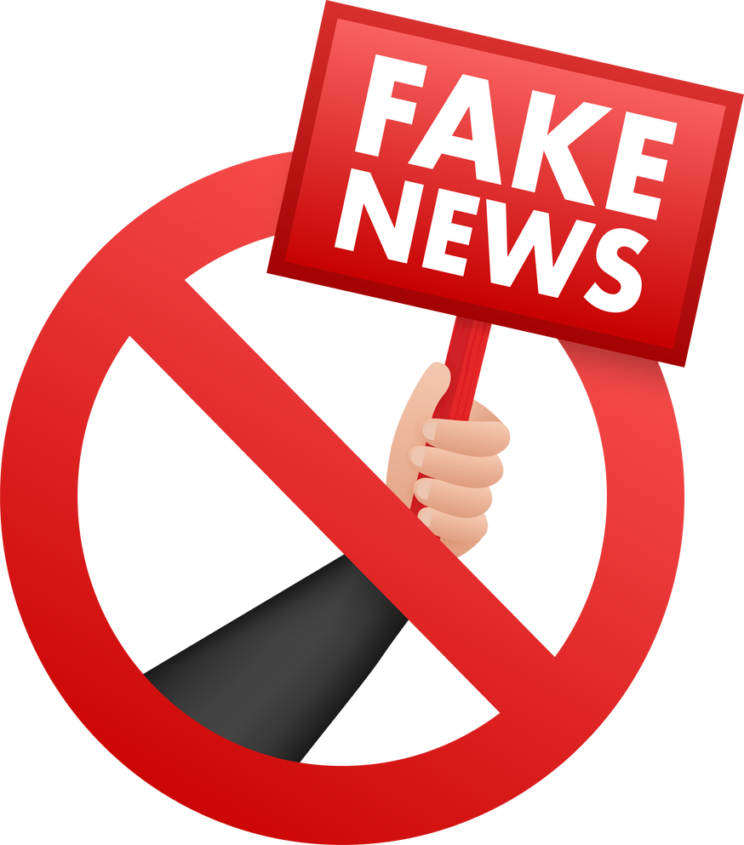



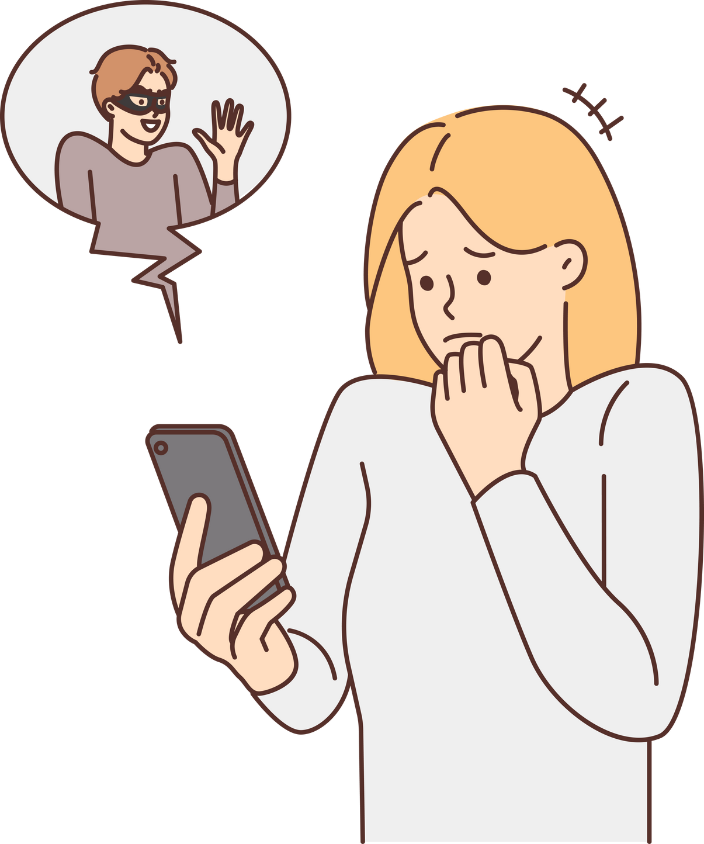
Why is Deepfake Unethical?
Spreads misinformation
Destroys public reputation
Violates personal privacy
Used for scams, blackmail, harassment
06

Slide 7
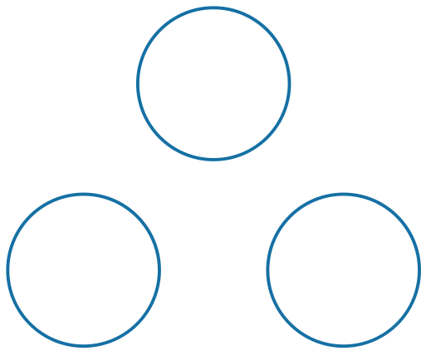
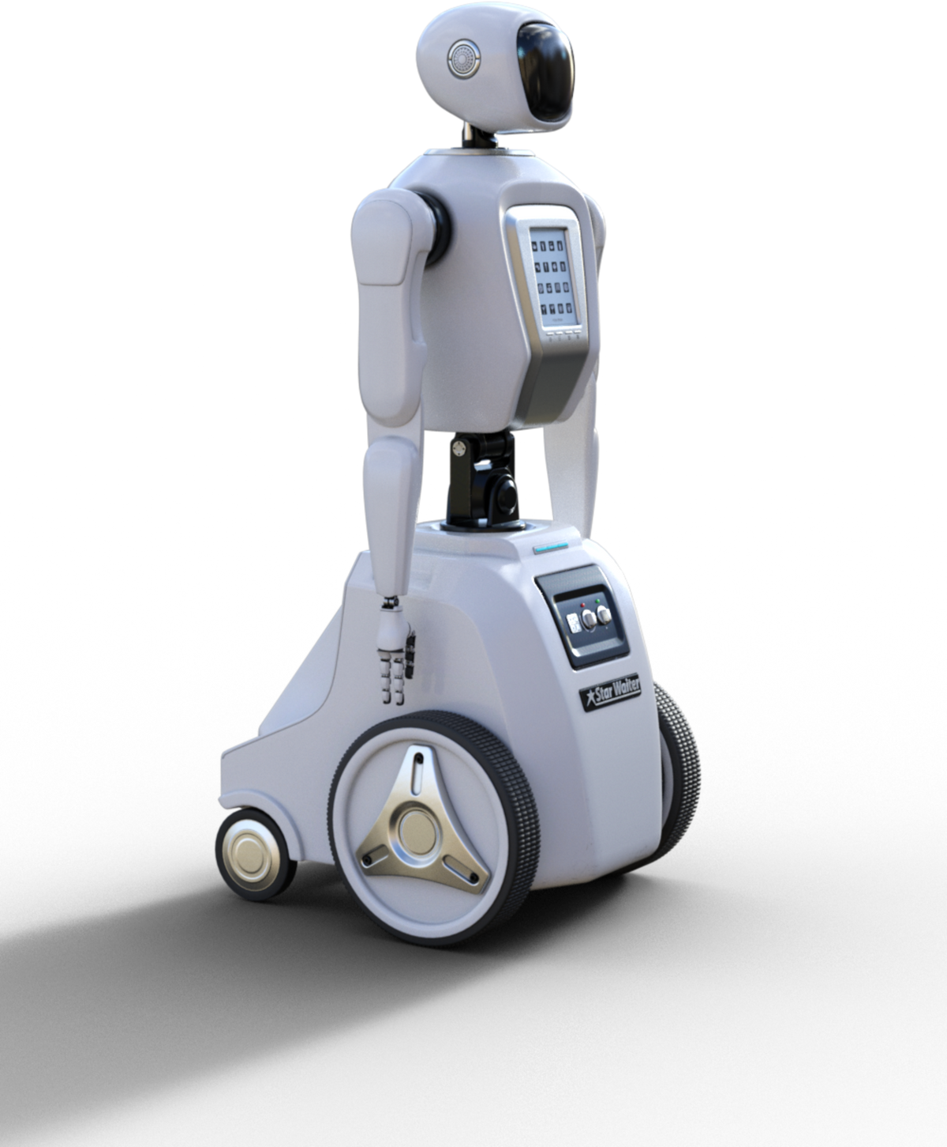
Deepfake’s Effect on Society
Spreads fake news & panic
Politically and socially harmful
Destroys trust in online content
Psychological distress to victims
07

Slide 8
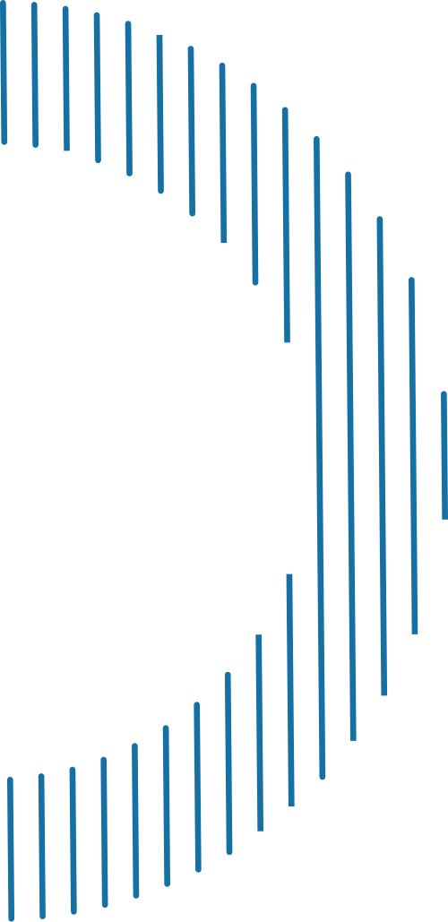
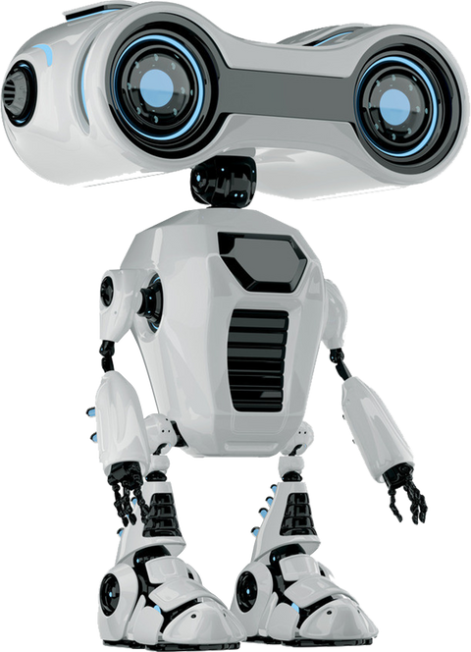




What Can We Do? (Solutions)
Develop AI deepfake detection tools
Apply strict social media filters
Enforce global cyber laws
Raise awareness through media
08

Slide 9
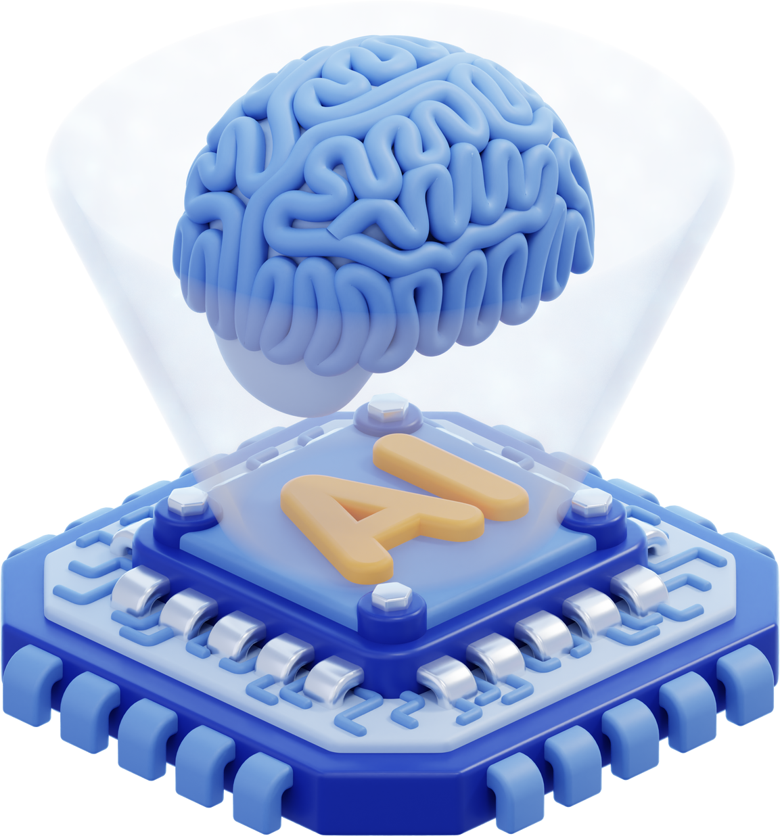
Conclusion
Real-life harm is already visible
We must use AI responsibly and ethically
Deepfake is a powerful but dangerous AI technology
09

Slide 10
10

